Slide 1


Shipbuilding-Shipbreaking
Spain2015
CCOO de Industria. Exige Industria

Slide 2


Presentation
Spanish shipbuilding-Shipbreaking sector is devoted almost entirely for export.
  Export 1.044 millons €
  Import 170 millons €
High international reputation for quality and tradition construction ,.
High standards in technologically advanced ships:
They give support to offshore oil rigs,
oceanographic vessels, factory vessels, etc.
The sector is mainly composed of medium-sized established companies, many family businesses have been consolidated for generations (employing 87,000 families directly and indirectly).
Construction activity is concentrated in Spain in industrial areas of Galicia, Asturias, Andalucia, Murcia and the Basque Country, but its real impact affects businesses and families across the country.
The shipbuilding sector has demonstrated its ability to generate short-term employment is the engine and the auxiliary industry.
Spanish shipbuilders are a world reference in shipbuilding and remain at the forefront of technological advancement.
CCOO de Industria. Exige Industria

Slide 3
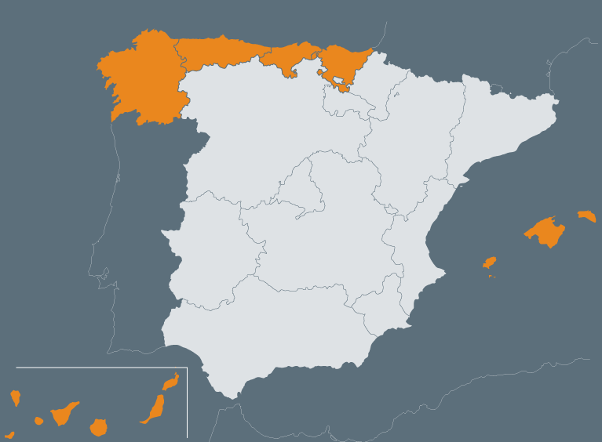
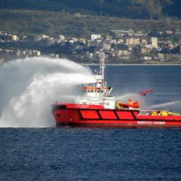
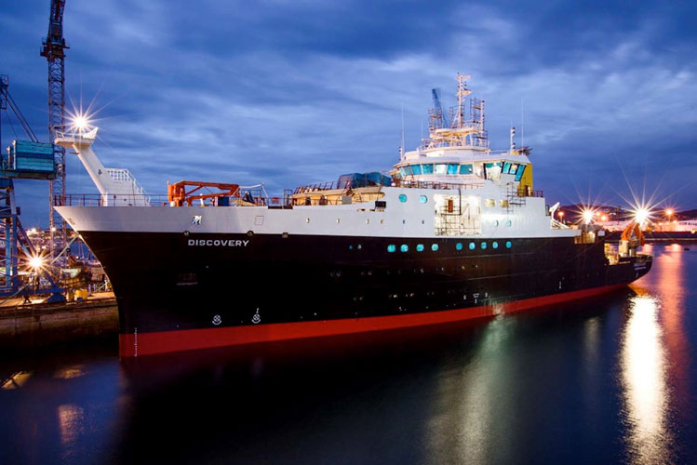
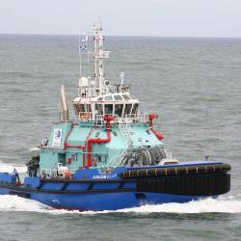
Shipyard builders, private
21 boat builders
1,600 permanent staff employees.
about 15,000 direct jobs in other subsidaries companies.
CCOO de Industria. Exige Industria

Slide 4
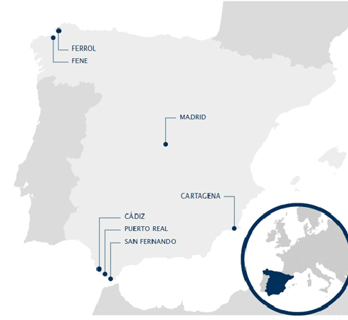
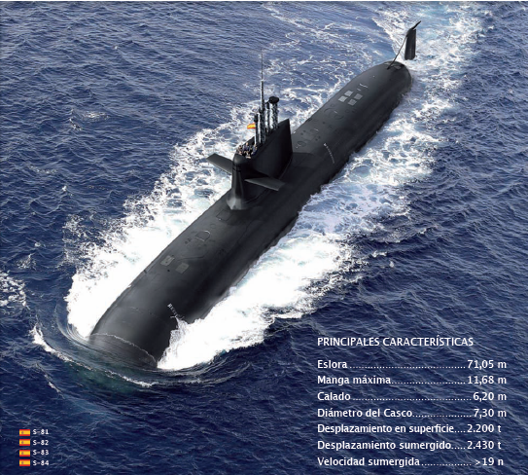
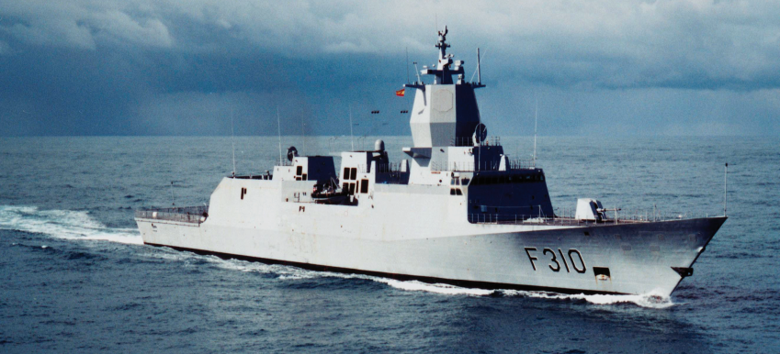
Shipyard builders state govern, NAVANTIA
6 builders with a staff of 3,836 workers and 5,000 direct jobs in other companies.
CCOO de Industria. Exige Industria

Slide 5





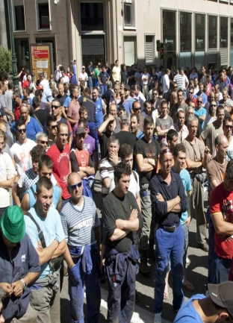
A Sector with a strong character of demands
Sector remains very constant processes of mobilization marked by workload demand, the demand for industrial betting that take into account this industrial activity and improving working conditions especially around health and safety
CCOO de Industria. Exige Industria

Slide 6
Industry defense
CCOO industry, as majority union in the naval sector, we maintain a permanent line of work in regional, national, European and Global levels to defend the strategic nature of the activity of shipbuilding and repair. For their employment, their ability to generate synergies and territorially secure the productive activity and maintaining employment.
https://www.youtube.com/watch?v=tpqFXKhfALs&feature=player_profilepage
CCOO de Industria. Exige Industria

Slide 7
Section 3.sustainable Industrial Policy and Developing Trade Union Nework- some questions to think..
Issues and challenges on the sustainable Industrial in Globalitation:
the fight by the globalization of rights (NO precarious work), to proclaim it, and to take it!!!.
Incorporating daily social action (consciously; the mix relation with the objectives),
  It is the interest of all (more visible actions by UNIONs)
    Increase and regular CBA sector (regular time, living wages, etcs).
      Increase, improving health&safety work.
    To develop CSR commitments 6,000/100 GFA (46 in IGU)
  and to achive Trade Union Network (to identify and to increase in the next years and to treat to build and to identify good experiences if to exist)
    Global Framework Agreements in the big brands (to build)
Particular responsibility of unionism headquarters multinationals.
  Building affiliates capacity union local.
But we must succeed in responding to the crisis, with challenges on the industrial policy and seeking collaborative common, synergies with other sectors, engineering, transport, oil…
CCOO de Industria. Exige Industria

