Slide 1


SMEEU Efforts in Promoting OHS & Women Participation in Workforce
IndustriALL Global Union Shipbuilding-Shipbreaking Action Group Meeting
1-2 November 2015

Slide 2
SMEEU Sharing on OHS Practices

Slide 3
Background
  In 2011 Singapore amended the Workplace Safety and Health Act (WSH Act) to:
  extend the Act to all workplaces instead just specific types of workplaces and factories
  extend the responsibilities of work safety to all individuals rather than confining to the supervisors, managers and companies

Slide 4
Major Challenges
  Major challenges in enforcement and compliance?
    To ensure fairness in the investigation and awarding of penalties.
    Regular enforcement needed
    Management of migrant workers with regards to HSE due to cultural and linguistic diversity.
    More effort put in the educating the workforce through training.

Slide 5
Improvement to OHS
    SMEEU leaders sit in the National Workforce Safety Council.
    SMEEU representatives in the HSE Investigation Teams and Grievance Committee of companies to ensure fair treatment.
    Union representation in the Yard HSE Committee
    Comfortable dormitories and facilities for the welfare of migrant workers

Slide 6
Better Working and Living Conditions for Foreign Workers
Unions and companies worked together to provide a better working and living conditions for foreign workers.
The Integrated yard at Tuas is a good example. Host 9000 workers
Good accommodation
Gym
Entertainment Centre
Medical Centre
Washing facilities
Football court etc

Slide 7
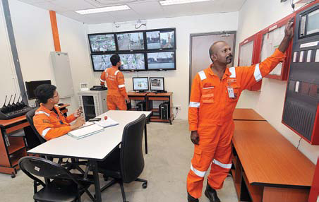
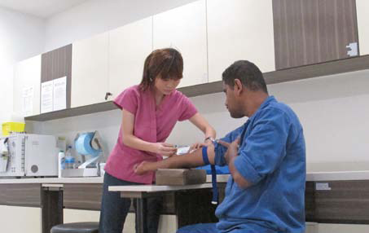
Better Working and Living Conditions for Foreign Workers
High standards of Health, Safety and Environment (HSE).
Well-equipped medical centre.

Slide 8
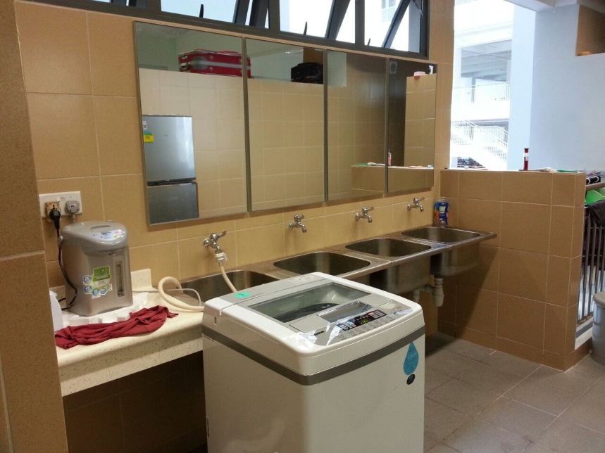
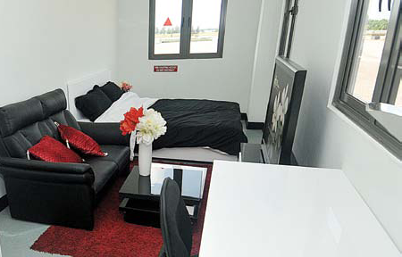
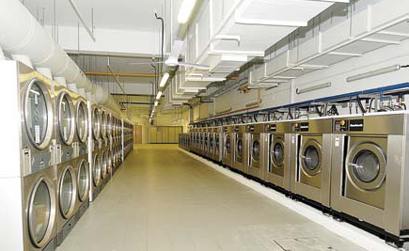
Better Working and Living Conditions for Foreign Workers
Neat and comfortable apartment.
In-house laundry services.

Slide 9
Enhancing Women Participation in the Workforce

Slide 10
Enhancing Women Participation in the Workforce
SMEEU work with NTUC to help women to get back and re-integrate into the workforce.
Back2Work U Programme
U Flex programme
Workpro programme
These programme help to recruit and place women in women friendly positions from employers across various sectors. After which there will be programme to encourage retention such as flexi-work arrangement etc.

Slide 11
Thank you!

