Slide 1

Hong Kong Convention and Sound Development of the shipbreaking Industry
IndustriALL Global Union
Shipbuilding-shipbreaking Action Group Meeting
Chittagong, Bangladesh; 2nd November 2015
Akira YAKUSUE
Akira YAKUSUE
Assistant General Secretary
Japan Federation of Basic Industry Workers' Unions (JBU )

Slide 2

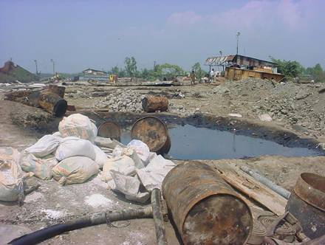
Development of global shipbreaking
million
LDT
Major recycling countries
(2014)
India 29.8%
Bangladesh 24.2%
China, PR 21.9%
Pakistan 18.0%
Shipbreaking plays a significant role in the maritime industry to ensure sustainable development of seaborne trade.
The volume of recycled ships are expected to be kept at the level of recent years. shipbreaking industry will generate a number of the employment in local communities.
Shipbreaking activities pose an enormous threat to the health and safety of the workers involved.

Slide 3

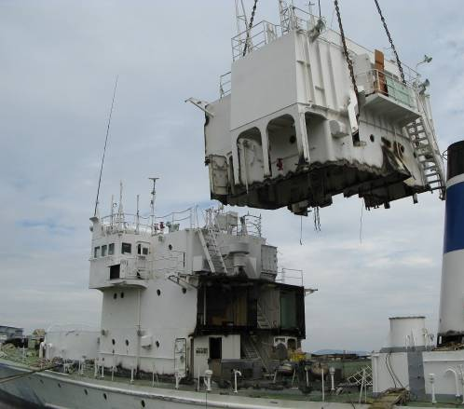
Importance of HKC
November 2014, IndustriALL adopted resolution that all the major shipbuilding, shipbreaking and shipping states expedite ratification of HKC.
(the IndustriALL Global Union world conference on shipbuilding-shipbreaking held in Nagasaki Japan)
The resolution referred to all existing international regulations and standards as follows.
  The Basel Convention Technical Guidelines
  The International Labour Organization (ILO) guidelines
  EU SRR (EU Ship Recycling Regulation)
  The Hong Kong International Convention for the Safe and Environmentally Sound Recycling of Ships (HKC)
Advantage of HKC
Covers from the cradle to the grave
  → Every stakeholder involved: equipment manufacturers, shipyards, ship operators, shipbreaking Facilities (SRFs)
Applied to all over the world
  HKC will be applicable to all over the world.
  (EU SRR is only applicable to EU member states.)
HKC is the most appropriate framework to ensure safe working conditions.
Early entry into force of HKC is important.
Since only three states ratified HKC, (Regrettably, no state ratified since adoption of the resolution.)
it is important to demand that their governments ratify HKC.

Slide 4

EU Ship Recycling Regulation
The EU Ship Recycling Regulation (SRR) will be applied to EU ships as early as by the end of 2016.
Additional requirements on the HKC to be imposed.
In order to recycle EU flagged ships, SRFs located outside of EU shall be listed in “European List”.
EU SRR may exclude shipbreaking yards in South Asia, even if they meet the requirements of HKC, causing the loss of employment in South Asia.
EU SRR may affect shipbreaking business in South Asia seriously.
Even worse, excluding shipbreaking yards in South Asia may become global de-facto standards.

Slide 5
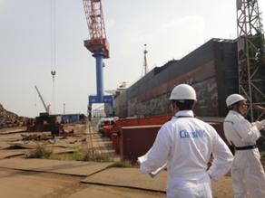
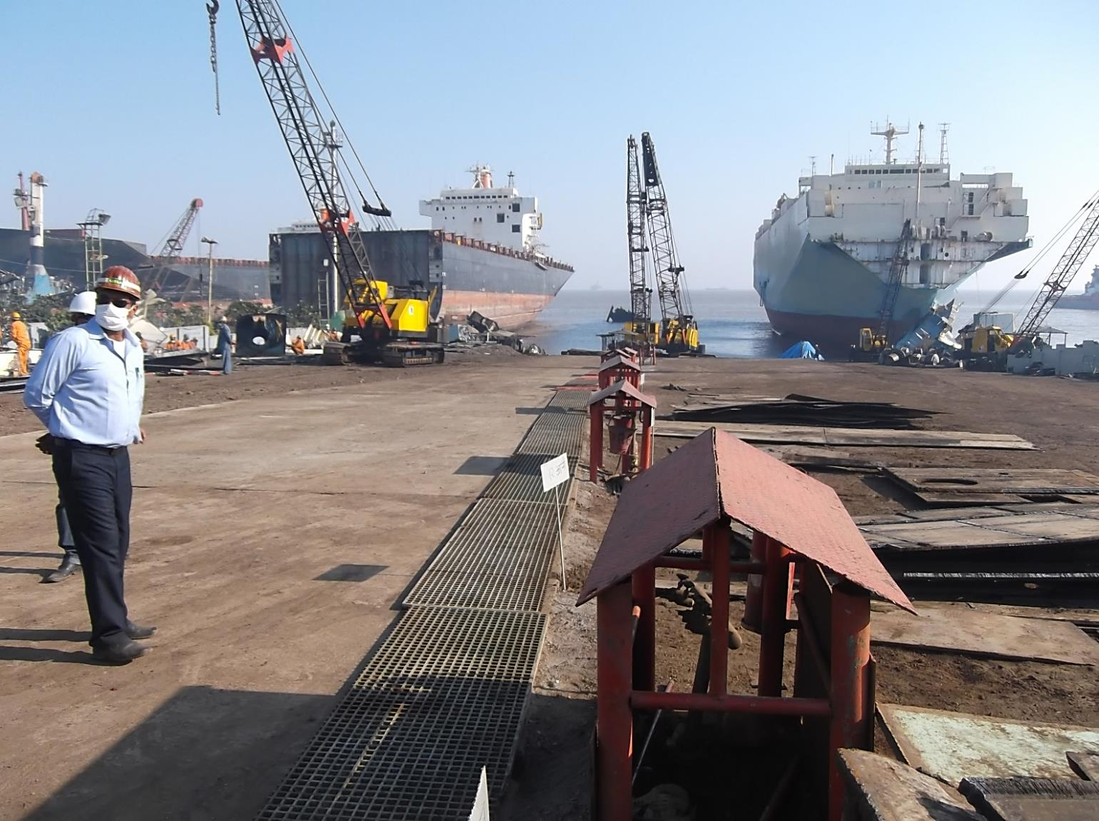
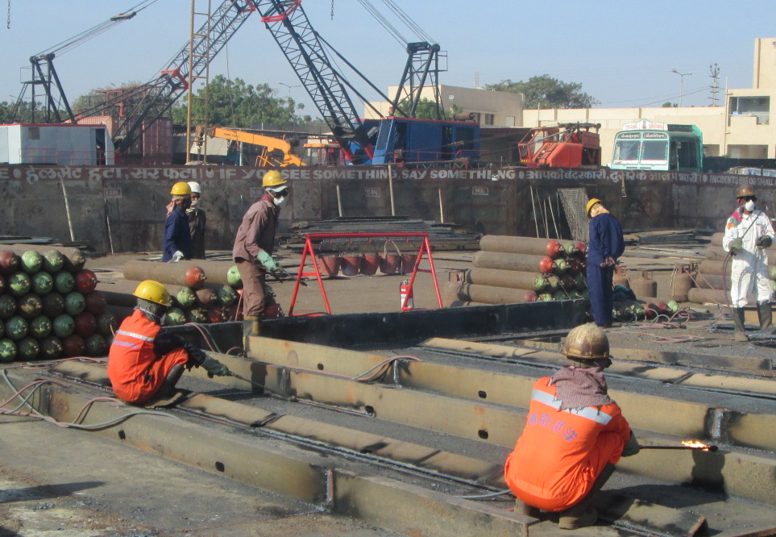
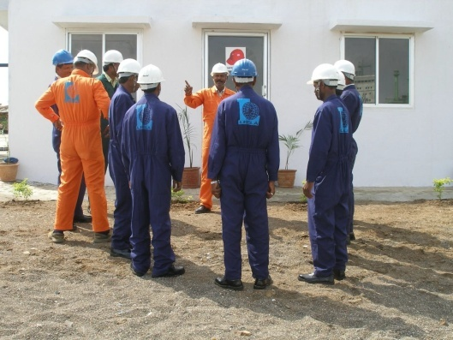
Certification by ClassNK and other actions
On September 29, ClassNK, one of the world’s leading classification societies, certified two shipbreaking yards in India (Kalthia Shipbreaking and Priya Blue Industries) as meeting the requirements of HKC.
Significance of the certification
Improved safety (ex. Training programme, emergency preparedness, prevention of falling from heights, personal protective equipment (PPE), provision of gas detector, etc)
Demonstrated that shipbreaking in South Asia can be improved up to international standards.
Other actions for improving safety of the workers
  IMO, Norway and Bangladesh started the project to ensure safe and environmentally sound shipbreaking.
Many of shipbreaking yards in South Asia have improved safety and environmental protection significantly. Continuous and further improvements are expected.
International community should support such efforts for the safe and sustainable employment of shipbreaking.

Slide 6
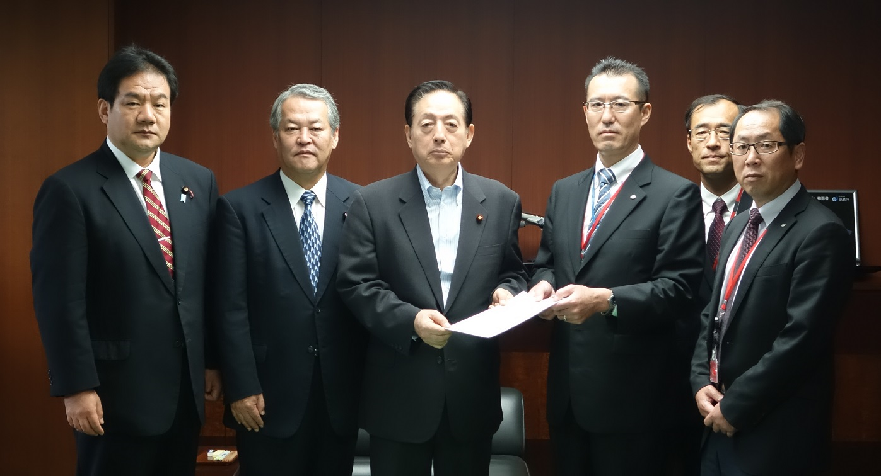
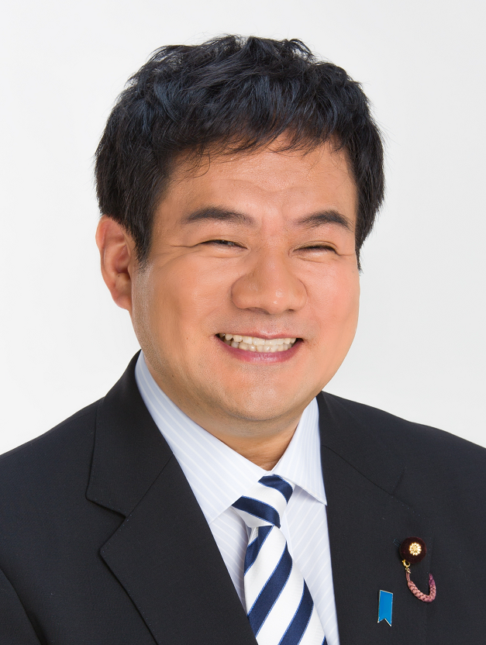

JBU : expedited ratification of HKC
09-09-2015, Satoshi KUDOH (President JBU)directly demanded to Akihiro
Ohta , Minister of MILT to expedite the ratification of the HKC by Japanese
Government.
Youichi KANEKO
Member of the House of Councilors
Rintaro OGATA
Member of the House of Representatives

Slide 7
Conclusion
Ensuring safe and environmentally sound shipbreaking is essential for workers of shipbreaking yards.
HKC is the most appropriate framework to improve safety of the workers.
Early entry into force of HKC is important.
Many yards are being improved. Further improvements are expected.
International community should support such efforts for the safe and sustainable employment of shipbreaking.
Thank you for your attention.

