Slide 1
IndustriALL Global Union
Shipbuilding-Shipbreaking
Action Group Meeting
Background Document
1-2 November, 2015
Chittagong, Bangladesh
Kan Matsuzaki- IndustriALL Global Union

Slide 2
Global Trends in Shipbuilding and Shipbreaking Industries

Slide 3
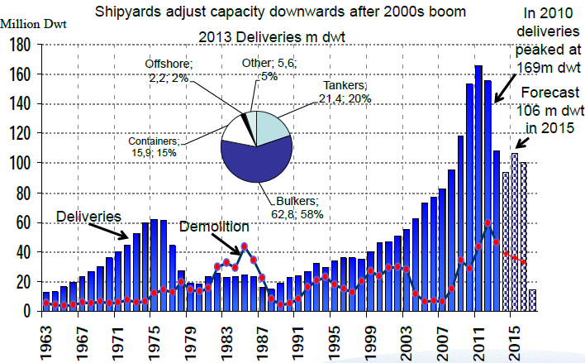
Trends in Shipbuilding Industry 1
Forecast predicts downwards trends in next 5 years
Source: Presentation by Maritin Stopfort@ SMM 2014

Slide 4
Trends in Shipbuilding Industry 2
The orders in 2013 were the 2nd highest ever.
After 2014, the orders are decreasing.
World New Orders
Country | 2009 |  | 2013 |  | 2014 |  | 2015 1st Half
 | ‘000GT | share | ‘000GT | share | ‘000GT | share | ‘000GT | share
Japan | 8,509 | 25.3% | 13,804 | 13.4% | 19,314 | 23.7% | 9,646 | 26.3%
S. Korea | 8,522 | 25.4% | 35,452 | 34.4% | 24,594 | 30.1% | 13,346 | 36.3%
China | 14,947 | 44.5% | 43,925 | 42.6% | 31,372 | 38.4% | 9,935 | 27.0%
Europe total | 521 | 1.6% | 1,311 | 1.3% | 2,260 | 2.8% | 1,086 | 3.0%
Brazil | 42 | 0.1% | 193 | 0.2% | 45 | 0.1% | - | -
Singapore | 15 | 0.0% | 8 | 0.0% | 87 | 0.1% | 12 | 0.0%
Taiwan | 264 | 0.8% | 1,021 | 1.0% | 293 | 0.4% | 1 | 0.0%
USA | 27 | 0.1% | 721 | 0.7% | 200 | 0.2% | 5 | 0.0%
India | 39 | 0.1% | 47 | 0.0% | 4 | 0.0% | - | -
Philippines | 604 | 1.8% | 3,474 | 3.4% | 1,933 | 2.4% | 2,275 | 6.2%
Turkey | 73 | 0.2% | 164 | 0.2% | 169 | 0.2% | 54 | 0.1%
Vietnam | 66 | 0.2% | 1,144 | 1.1% | 141 | 0.2% | 237 | 0.6%
World total(‘000GT) | 33,600 |  | 103,200 |  | 81,600 |  | 36,736
Data Source: The Shipbuilders’ Association of Japan(SAJ)
Ship Size Coverage: 100 Gross Tonnage and over
Europe Total = Former AWES(present SEA Europe)

Slide 5

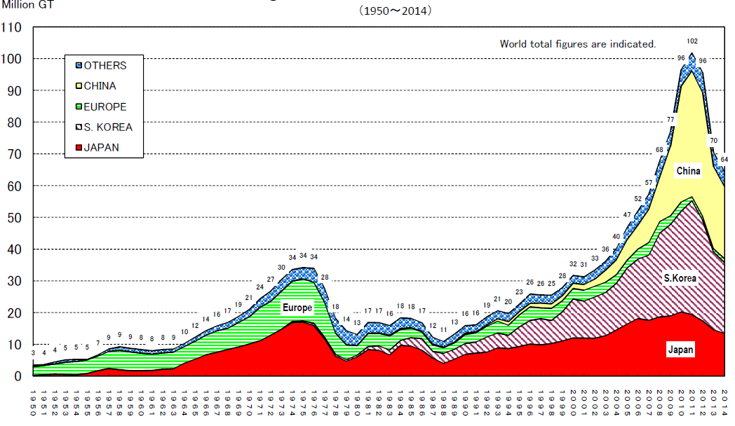
Trends in Shipbreaking Industry 1
Shipbreaking will continue to increase
The amount of shipbreaking will be tripled in next 25 years.
Fleets’ age 25+
(now being breaking)
Source: “Shipbuilding Statistics” September 2014, the Shipbuilders’ Association of Japan

Slide 6
Shipbreaking by Countries
South Asia region- India, Bangladesh, and Pakistan account 72% of world shipbreaking in gross tonnage.
Trends in Shipbreaking Industry 2
GT
Declining in short term
Source: “Shipbuilding Statistics” September 2014, the Shipbuilders’ Association of Japan
Notes:
Suddenly, the thousands of tons of steel generated by Alang's ship recyclers cost more than much of what China is sending to Indian shores. The impact has been profound. The number of Alang ship breakers has declined to 50 from 100 last year.Alang, hobbled by a collapse in steel prices, is in little position to make capital investments, much less compete against a Chinese state-subsidized industry. From January to April, before the most recent tumult hit full force, China recycled 65 ships, 24.8 percent of the 262 scrapped worldwide during the period, according to the NGO Shipbreaking Platform, behind India's 69 and Bangladesh's 66. In all likelihood, it will be No. 1 in the next quarter.

Slide 7
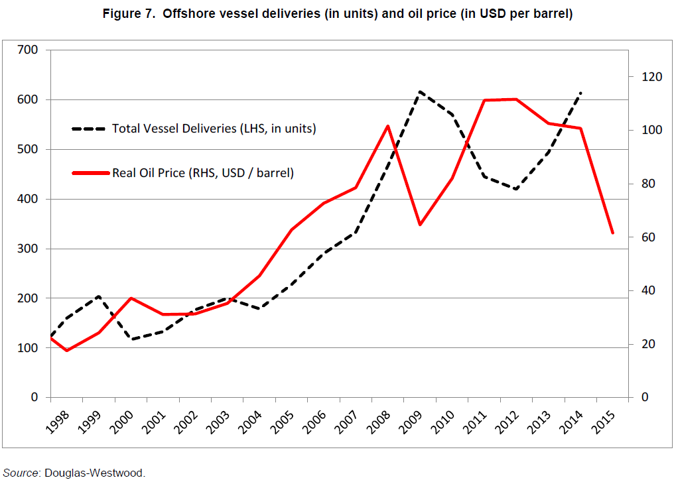
Trends in Offshore Industry 1
Offshore vessel deliveries are expected to decrease by at least 10% in 2015, and further decreases are expected in 2016 and 2017.
OECD WP6
Notes:
Figure 7 below shows the high level of correlation between offshore vessel deliveries with a two-year lag and the oil price. If this correlation persists over the coming years, we can expect a decrease of offshore vessel deliveries in 2015 by at least 10%, and further decreases in 2016 and 2017. Nevertheless, over the medium-term, Douglas-Westwood is relatively confident on the offshore vessel market and expects demand for all offshore vessel types to increase by 3.7% per year on average between 2014 and 2025 driven by growing offshore oil and gas supply in the coming years notably in deep offshore fields.

Slide 8
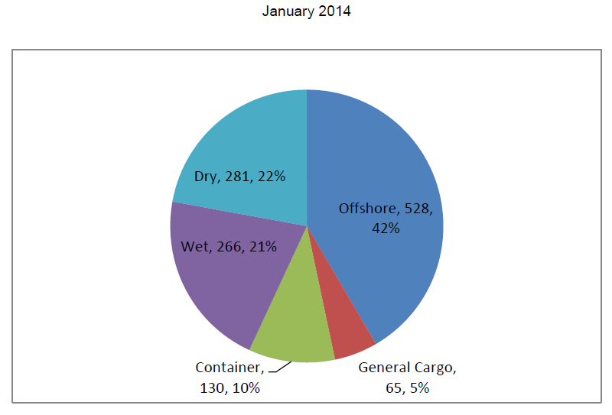
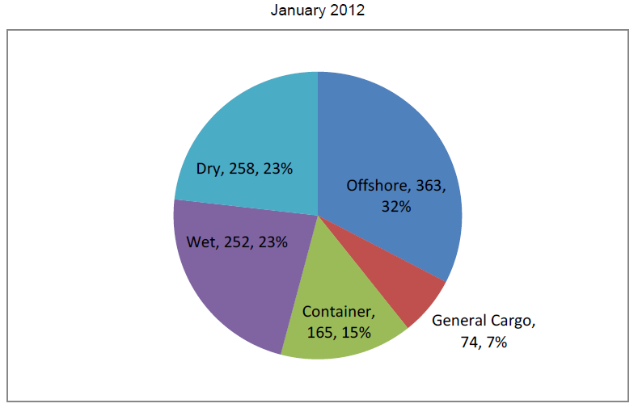
Trends in Offshore Industry 2
Offshore segment increased from 32% in January 2012 to 42% in January 2014 of total ship financing
Outstanding world exposure by shiptypes for all sources of funding (In billions USD)
OECD WP6
Source: Tufton Oceanic.
Notes:
Mr. Mowinckel, Assistant Managing Director, Market Analysis and International Relations at the Norwegian Export Credit Agency (GIEK) showed that the outstanding exposure to the offshore segment increased from 32% in January 2012 to 42% in January 2014 of total ship financing. Several types of policies have a significant impact on the shipbuilding sector in the context of its offshore activity, in particular local content requirements which are applied in various regions, increasing costs and uncertainty of offshore projects.

Slide 9
Sectoral Activities

Slide 10
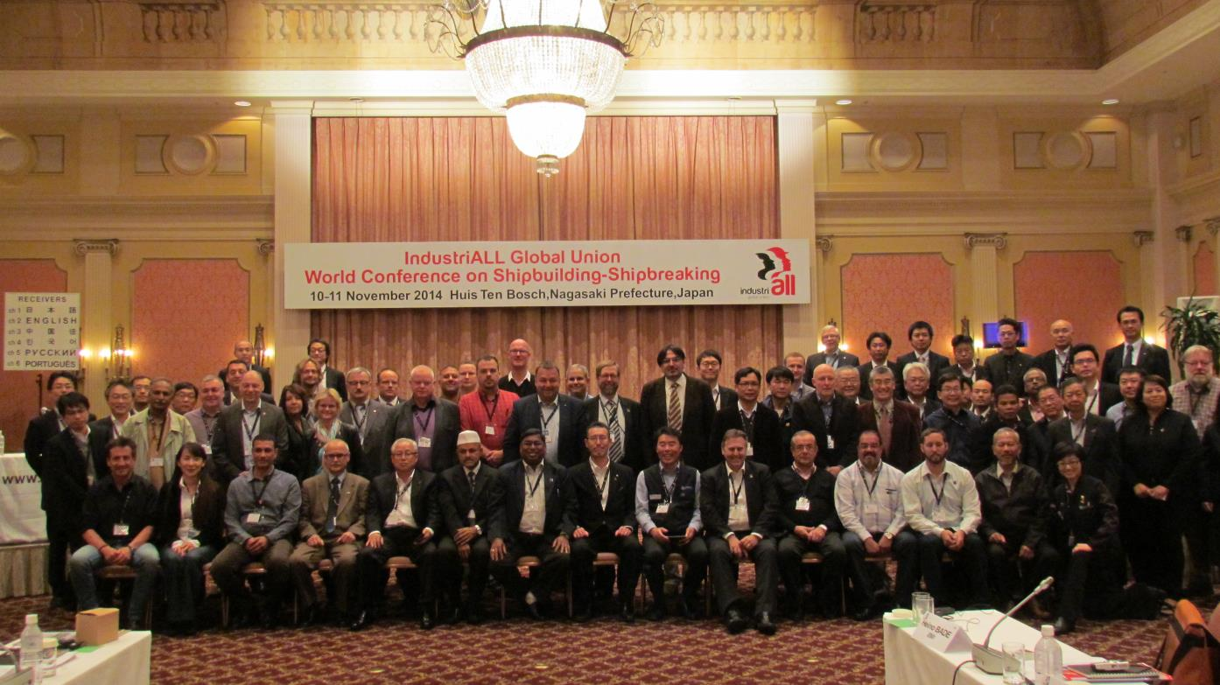
IndustriALL World Conference on Shipbuilding-Shipbreaking
10-11 November 2014
Huis Ten Bosch/Nagasaki Prefecture, Japan
83 participants from 24 unions in 19 countries(Australia, Bangladesh, Brazil, Denmark, Finland, France, Germany, India, Indonesia, Japan, Korea, Netherlands, Norway, Pakistan, Russia, Singapore, Taiwan ROC, UK and USA.)

Slide 11
IndustriALL World Conference on Shipbuilding-Shipbreaking
Action Plan for 2015-2016
1. Build union power throughout the world by –
Action Plan | Development
Focusing on organizing and gaining union density in emerging shipbuilding-shipbreaking countries such as Bangladesh, Brazil, Indonesia, India, Pakistan, Turkey, and Vietnam. | IndustriALL-FNV organizing project(from 2003) in 3 countries( India, Bangladesh and Pakistan) CBA training in Batam Isd, Indonesia in August JBU - CNM-CUT initial discussion in April 2015 JBU – SMEFI Bilateral cooperation project (next 3 years)
Supporting the development of strong, democratic, independent, representative and sustainable trade unions in the shipbreaking industry in South Asia region through bilateral or multilateral cooperation projects.
Reaching out to unorganized workers and precarious workers (agency workers, subcontract workers, migrant workers, etc.) to include them in the protection of a collective agreement.

Slide 12
Compliance with Core Labour standards: Ratification of ILO fundamental Conventions by major shipbuilding-shipbreaking countries
Country | Freedom of association |  | Forced labour |  | Discrimination |  | Child labour
 | C087 | C098 | C029 | C105 | C100 | C111 | C138 | C182
EU
Turkey
Brazil
Australia
Bangladesh
China
India
Indonesia
Japan
Korea, Republic of
Malaysia
Pakistan
Philippines
Singapore
Viet Nam
USA
source: ILO NORMLEX

Slide 13

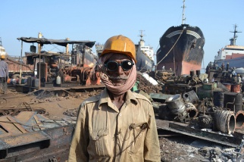
Example of creating local unions in India
Planning and Finance
SMEFI
Joint Training/Education
MPTDGEU
Mumbai
FNV
Additional
Support
Organizing
Create another union
Expand tactics
ISCOS
ASSRGWA
Alang/Sosiya
Expand support to other unions
Organizing
Shipbreaking Unions Network in South Asia
SMEFI(India)-BMF/BML(Bangladesh)-NTUF(Pakistan)

Slide 14
IndustriALL World Conference on Shipbuilding-Shipbreaking
Action Plan for 2015-2016
2. Confront global capital by –
Action Plan | Development
Developing the process of creating Trade Union Networks (2-3 networks by 2016) at all levels, such as MNCs, commercial/naval sectors, regions, and countries. | BAE TUN has launched in November Seeking possibility for Meyer, STX, Keppel, Damen, etc.
Seeking opportunities to negotiate Global Framework Agreement with shipbuilding MNCs | Not yet

Slide 15







Creating TU Network
BAE TUN launched in Nov. 2014
EUROPE
North America
REGIONAL
Other
ASIA&PACIFC
Latin America
Commercial
NAVAL
MNCs

Slide 16
IndustriALL World Conference on Shipbuilding-Shipbreaking
Action Plan for 2015-2016
3. Defend workers’ rights by –
Action Plan | Development
Taking solidarity action against attacks on workers’ rights wherever they occur | RR Korea(resolution in WC, in Nagasaki) has been solved. Hyundai Heavy Industry contract workers case(ILO -CFA)
Demanding that governments expedite ratification of the IMO’s Hong Kong Convention | Global campaign on HK convention(1st phase)
Promoting OHS in both shipbuilding and shipbreaking | Updating news on the campaign website
Achieving 30% women’s participation in the events/meetings by effectively focusing on the gender agenda of shipbuilding-shipbreaking workers. | No concrete development

Slide 17

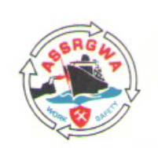




Action Taken by Unions (July - Oct. 2015)
Positive reaction/attention by the governments, shipbuilders/owners, NGOs and Media
What is next?

Slide 18
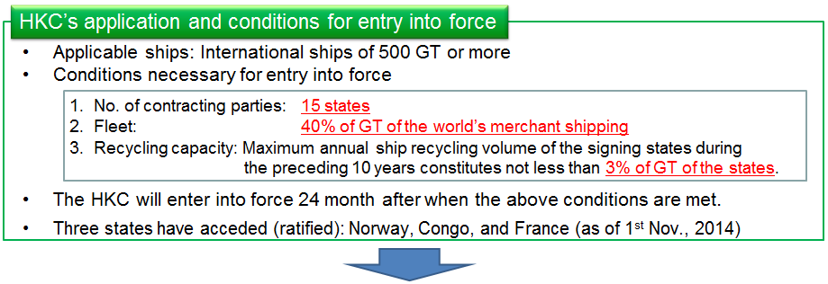
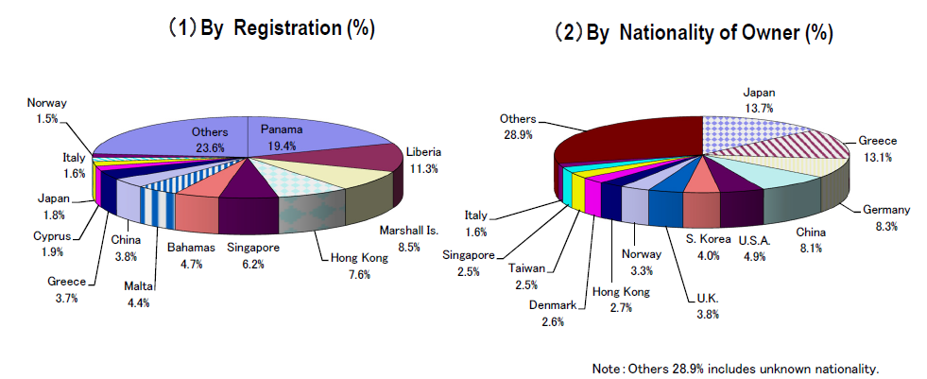
Source: MILT
Marchant Fleets Share(%) (as of end 2013/GT Basis)
Source: SAJ

Slide 19
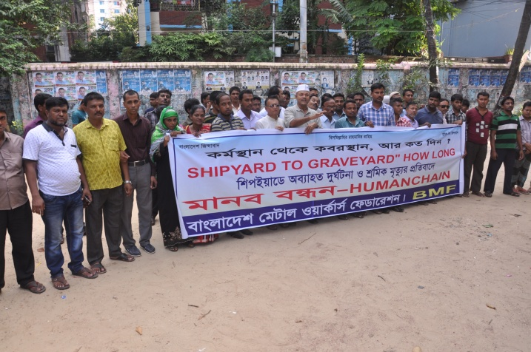
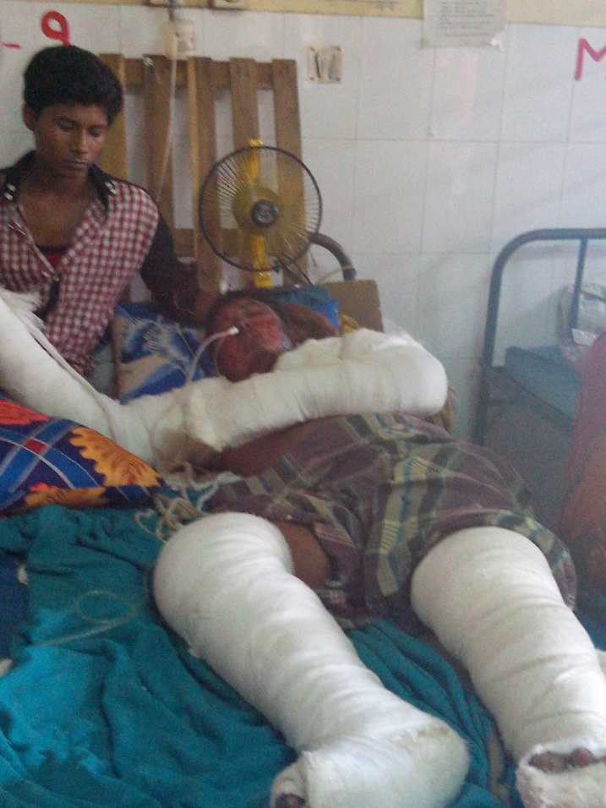
OHS situation in Shipbreaking industry
Worst in Bangladesh
According to OHSE monitoring, dead and injured in shipbreaking sector from January 2008 to June 2013 are 197(78 dead, 119 injured). But the figures are only reported by the 15 national newspapers, and OHSE estimate the real figures might be 20 times more.
Recent cases:
5 September 2015: Four workers were killed following a gas cylinder explosion in the Shital Shipbreaking yard in Chittagong.
20 October 2015: Three workers were killed in S. R. Corporation, one of the major shipbreaking companies in Chittagong.

Slide 20
IndustriALL World Conference on Shipbuilding-Shipbreaking
Action Plan for 2015-2016
4. Fight precarious work by –
Action Plan | Development
Continuing to motivate joint actions by affiliated unions throughout the process of Fight Against Precarious Campaign. | More visible actions taken by unions on 7 October
Increasing the number of examples of limits to the use of precarious workers in CBAs through the sharing of good practices between the affiliates. | Need to research
Develop trade union networks to fight against the growth of precarious work in the sector and to defend shipbuilding-shipbreaking workers’ rights | BAE TUN has launched in November Seeking possibility for Meyer, STX, Keppel, Damen, etc.

Slide 21
Standard Wages of Manufacturing Workers in major shipbuilding-shipbreaking countries
(2014, in US dollar/month RED: Engineer BLUE: Production)
Standard Wage of middle-skilled shipbreaking workers (in 2013)
Mumbai, Inida 95 US dollar/month
Gadani, Pakisatan 4 US dollar/day
Chittagong Bangladesh 2.5 US dollar/day
Data Source: JETRO

Slide 22


Fight against Precarious Work
Continue to take action!

Slide 23
IndustriALL World Conference on Shipbuilding-Shipbreaking
Action Plan for 2015-2016
5. Ensure sustainable industrial employment by –
Action Plan | Development
Building affiliates’ capacity to develop and implement their own vision of sustainable industrial development by the sharing of good practices | Mainly information exchange at meetings
Developing collaborative activities and seeking synergies to effect sustainable industrial policies, with other sectors such as Mechanical Engineering and Oil & Gas | Area of common industrial policy to be identified in 2016
Actively getting involved in the process of creating the ILO’s proposed new code of practice on Safety and Health in Shipbuilding and Repair | Preparing for the ILO expert meeting in November 2017

Slide 24

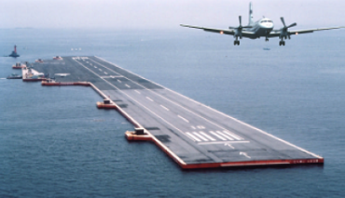
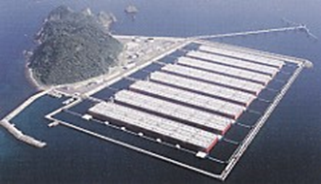
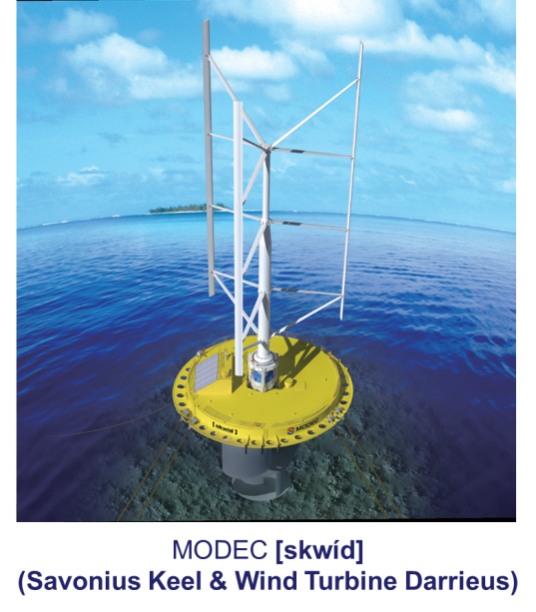
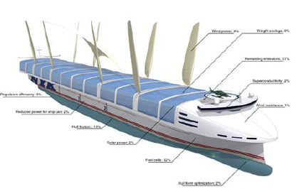
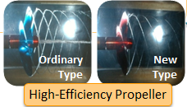
New Technology/Product
Promoting sustainable technologies/products will bring sustainable employment
Large-Sized Floating Offshore Structure (Mega Float)
Air-lubrication System
Super Eco-ship
Floating Wind & Current Hybrid
Power Generation

Slide 25
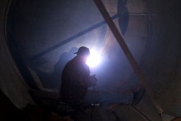

Thank You
Website
www.industriALL-union.org
Industri ALL

