Slide 1
United for a Just Future
Time to Pay Up!

Slide 2
Define the problem
Inequality is growing globally
Workers’ rights violations, attacks on unions and democracy
The cost of living crisis
Income inequality
The gap between productivity gains and wage growth
An unfair distribution of wealth
Jobs threatened by Industry 4.0 and climate change
The food and energy security crisis caused by the war in Ukraine and climate change
Supply chain disruption
Waves of migration and refugees
New forms of precarity through platform work

Slide 3
The idea
An IndustriALL Global Union campaign that works for everyone
Inequality is growing globally…
…but people experience it differently in different sectors, regions and countries
We represent a diverse range of affiliates and need a campaign that works for everyone

Slide 4
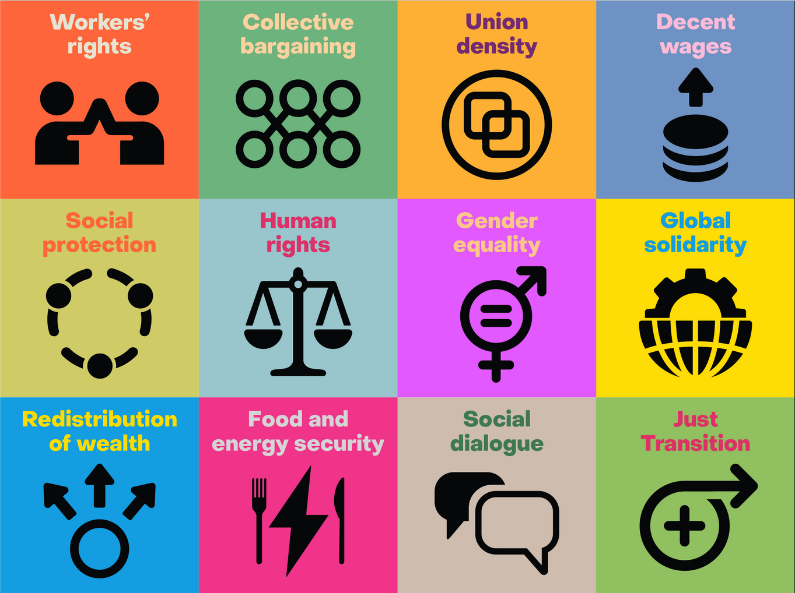
Suggest solutions
Building blocks for a Just Future
Notes:
Fundamental workers’ rights, with full implementation of ILO Convention 87 and
Convention 98, and labour laws at national level that allow workers to defend
themselves;
• Enhanced collective bargaining coverage, with better conditions delivered by strong
unions;
• Union density: we need to organize more workers in more sectors and bring them
under the umbrella of collective agreements;
• Decent wages. Workers everywhere need a pay rise that reflects the inflation rate and
the sacrifices made during the Covid pandemic; they need wages that reflect their
essential part in value creation;
• Social protection, including unemployment, sick pay, maternity and paternity leave,
funds for retraining and properly funded pensions;
• Human rights due diligence that allows us to hold companies to account using
accessible legal mechanisms;
• Gender equality that ensures women have their share of well-paying jobs, and receive
equal pay for work of equal value;
• Global solidarity against the scourge of racism, with support for migrants and
refugees;
• The redistribution of wealth through tax justice, including a windfall tax on those who
made a fortune from Covid, and investment in society;
• Just transition. We need a funded plan, developed through social dialogue, to manage
the transition to net zero and replace carbon-intensive work with quality, green,
unionized jobs;
• Food and energy security to provide sustainable access to basic needs at an affordable
cost, especially in relation to the growing number of low-income households;
• Social dialogue that enables all stakeholders, including workers, to engage in national
policy formulations to improve their living standards

Slide 5
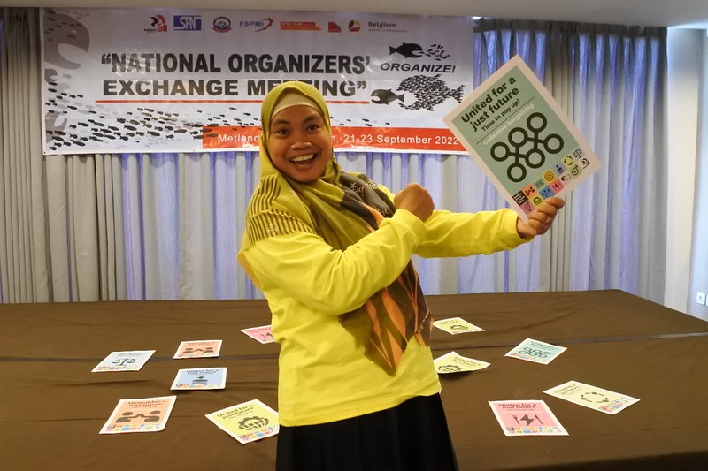
Unite around 7 October
World Day for Decent Work is already in the calendar
Unions can chose the most relevant building blocks
They can chose the most appropriate action

Slide 6
Action taken around the world
Across Europe
Japan
Indonesia
The Philippines
USA
Bangladesh
Pakistan
Madagascar
Mauritius
Botswana
Peru
Norway
Spain
Kenya
Georgia
Tanzania
Iraq
New Zealand
South Korea

Slide 7
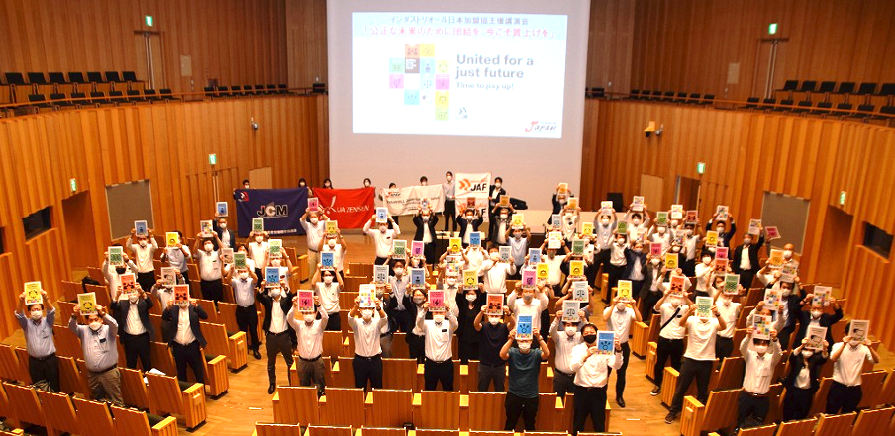
Japan
Seminar on decent wages to prepare for the next roundof wage negotiations

Slide 8
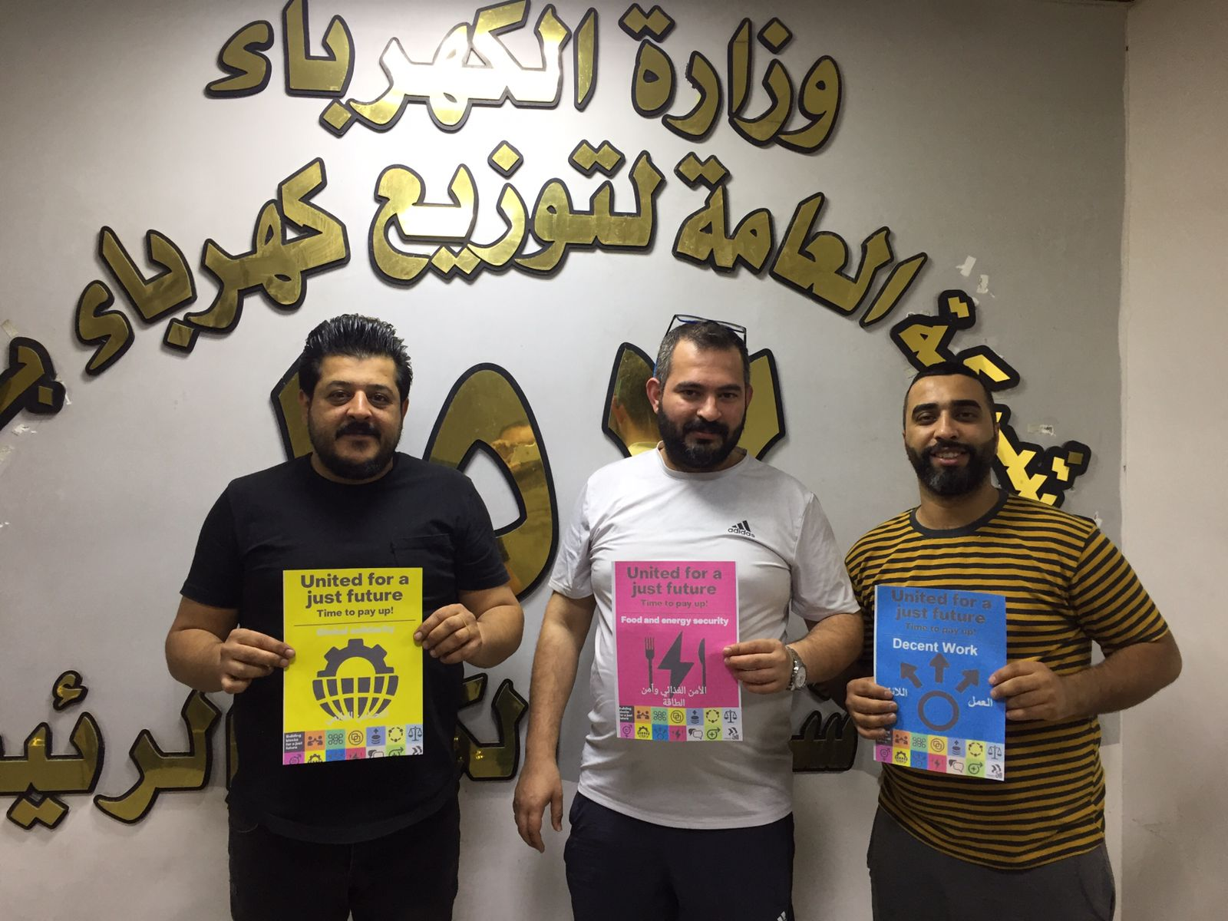
Iraq
Global solidarity, food and energy security, decent work

Slide 9
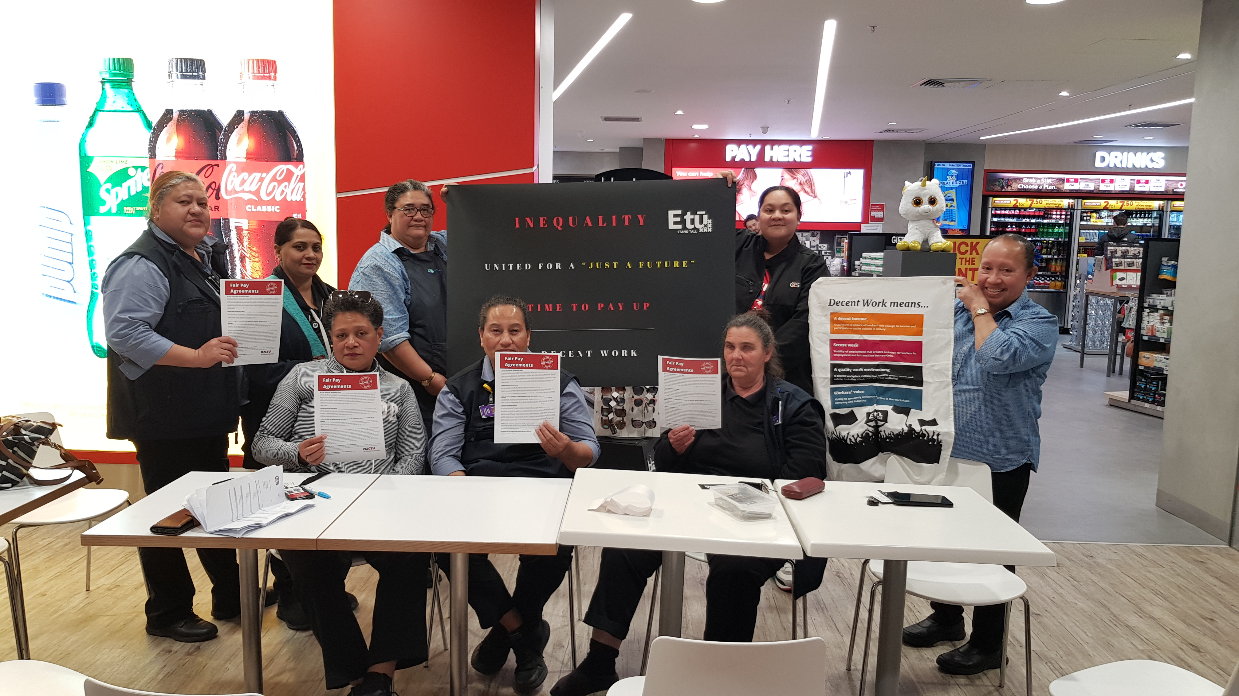
New Zealand
Decent work

Slide 10
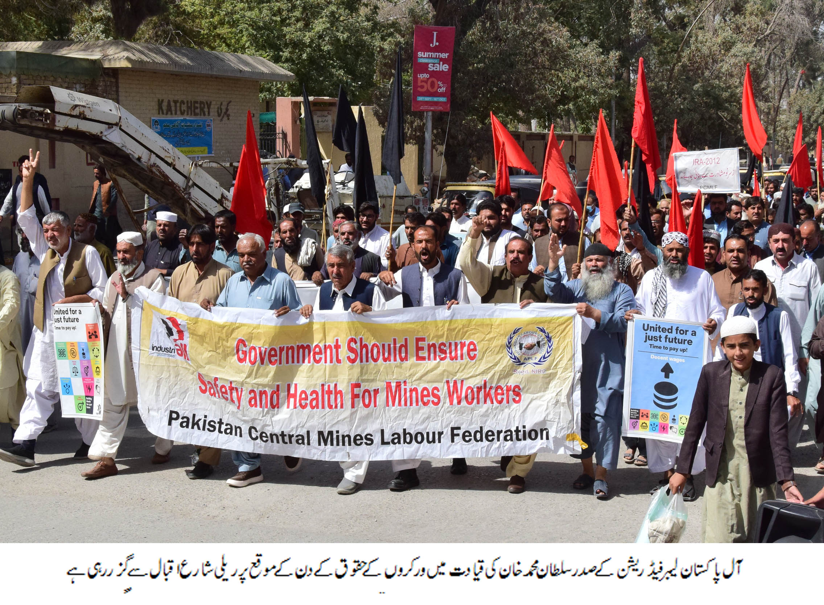
Pakistan
Workers’ Rights – core ILO Conventions including 176

Slide 11
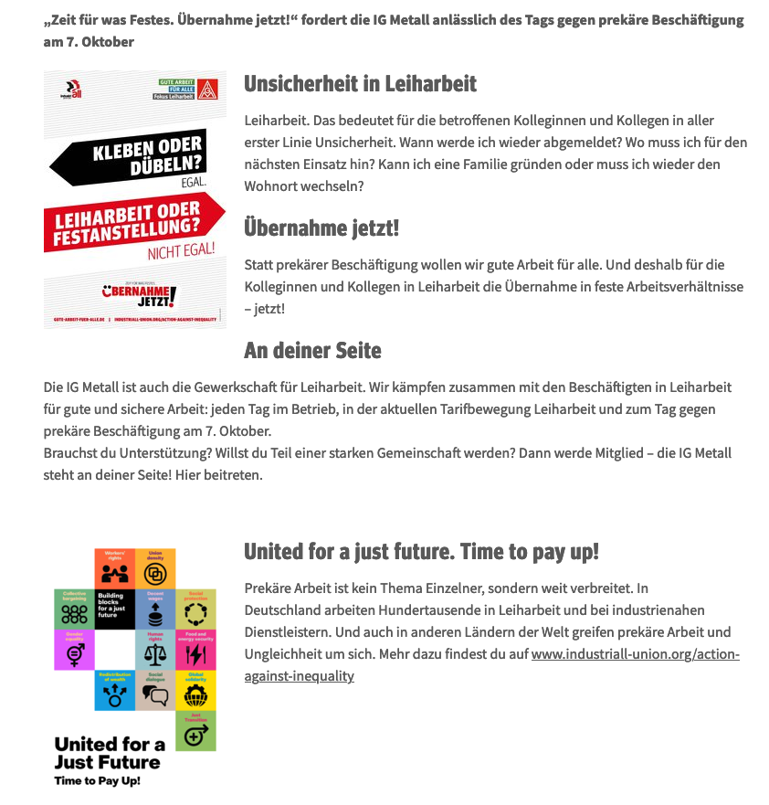
Germany
Decent work

Slide 12

Tanzania
Decent Work

Slide 13
