Slide 1
Formalising Artisanal and Small Scale Mining: Problems, contradictions and possibilities
Hibist Wendemu Kassa, PhD
Postdoctoral Research Fellow
Southern Centre for Inequality Studies
University of Witwatersrand

Slide 2
INTRODUCTION
Part of a broader PhD thesis compared gold mining in Ghana and South Africa integrates fieldwork this year; one key finding is the central role of the state; contradictory
In South Africa, after 1994 policy sought to transform the mining sector, ASM was part of this vision. Space has been created for some operations to enable the emergence of black capitalists; the dominance of LSM operations has closed the space for artisanal and small-scale forms of mining operations
ASM is a broad category and includes junior miners at the larger scale end of the spectrum. Term jumbles together rudimentary forms of mining and self employed operations with large scale more mechanised operations
criminalised forms of mining are also determined in relation to nature of commodities in question (non-precious minerals tend to attract less state interest), contestation over concessions.
Central problem: policy interventions tend to undermine the transformation of petty commodity production and petty capitalism in mining into safer or sophisticated ventures

Slide 3
General conceptual framing
Amin (1976 :237) contrasts the articulation of developed economies, as integrated entities, with the disarticulation of underdeveloped economies which are not similarly integrated.
Amin (1976: 245) highlights consequences for capital accumulation in the periphery. Integration in the global markets undermines investment by local capital in industry.
ASM emerges in the aftermath of structural adjustment and economic reform programs as an organic response to large scale retrenchment in mining, but also crisis in livelihoods and social reproduction

Slide 4
Obuasi and dispossession of indigenous mining
Honeycomb method: Precolonial mining operations centred on surface deposits in soft oxides using pits as low as 5 to 20 feet. Later pits were 30 to 60 feet deep and 2 to 3 feet wide. Families worked pits together and surface level mining was worthwhile.
Crown Lands Bill drafted in 1894 to transfer ownership of unused or unoccupied lands. To enable the entry of British plantation agriculture and secure control over gold production.
1000 indigenous miners were dispossessed with the entry of Ashanti Gold Company formed out of the local Cot D’or mining firm
1905 indigenous gold mining banned; 1989 legalisation of ASM by PNDC repeals ban

Slide 5
GHANA CONTEXT
Ghana case: Anglo Gold Ashanti concession covers almost the entire Obuasi Municipality which is 220.7 square kilometres; dominant and only corporation in Obuasi
Agriculture accounts for a high share of employment at 40.65%, also has a low and falling share of GDP at 17.2% (World Bank, 2017).
Deagrarianisation that is agriculture is being displaced as the main livelihood activity in rural communities. Combination of factors including ASM
Estimated that there are about 1 million who are directly, 4-5 million indirectly
Reforms introduced in 1989; ASM mining law as specific legislation. Regulation led to a different form of criminalisation
Culminates in 2017, the government of Ghana imposed a nationwide ban on artisanal and small scale mining. Operation Vanguard led by special military units across the country occupy Obuasi

Slide 6
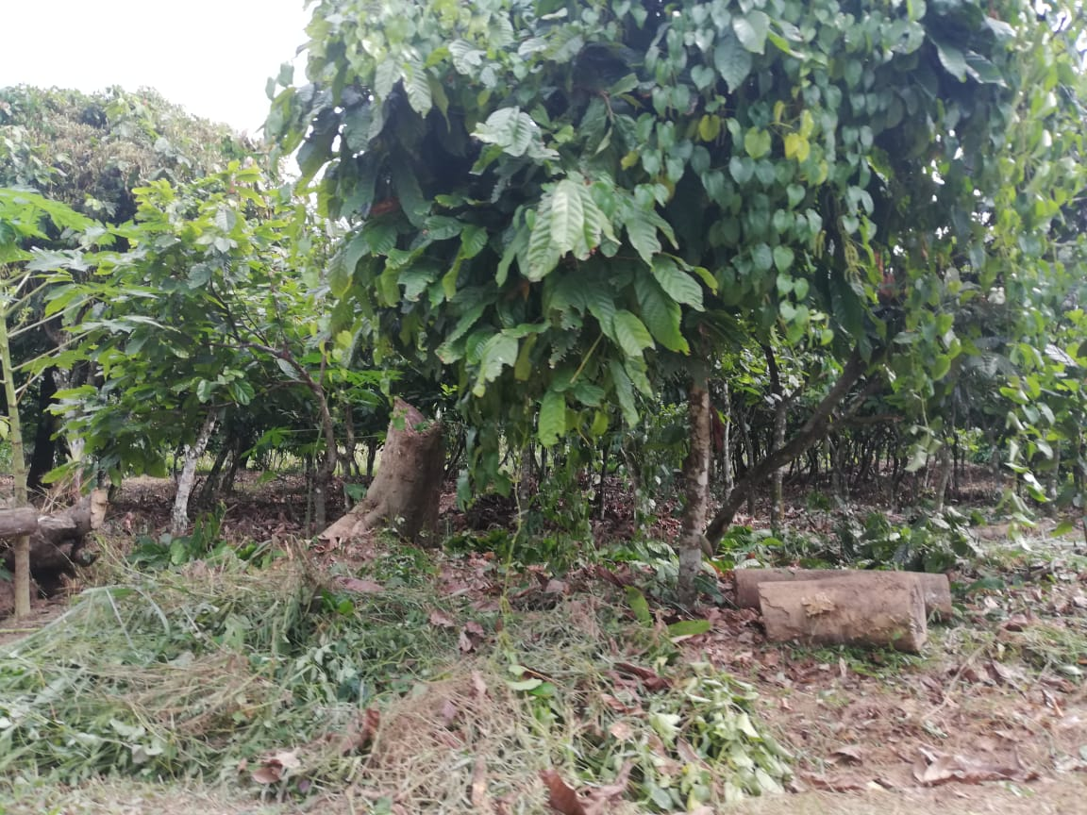
Cocoa farm next to ASM site

Slide 7
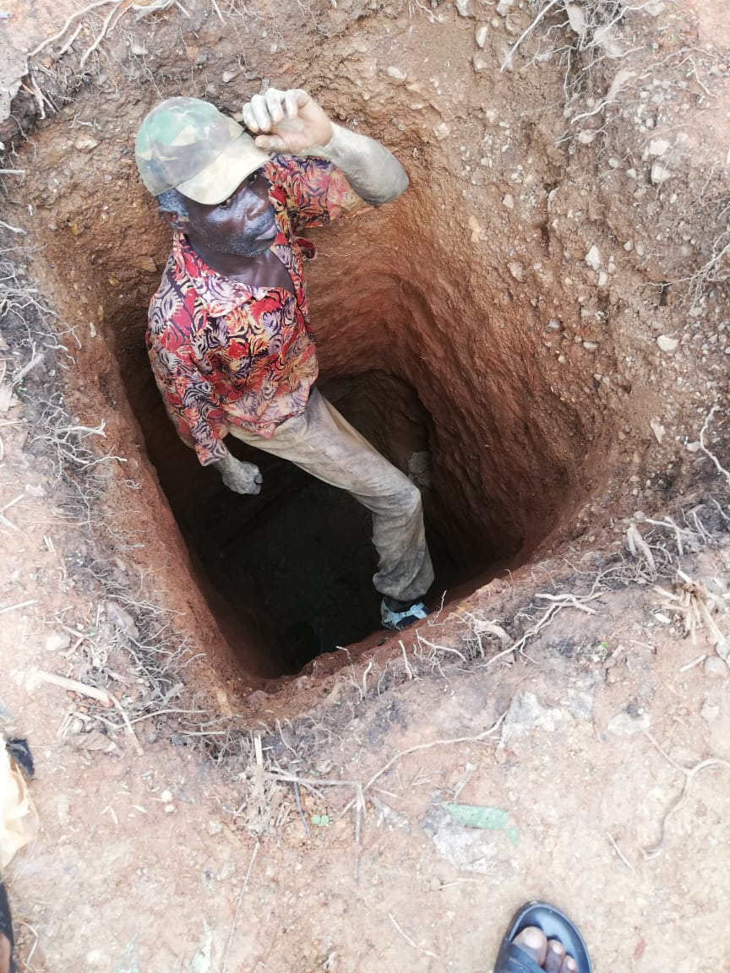
Honeycomb mine shaft; 40 feet deep

Slide 8
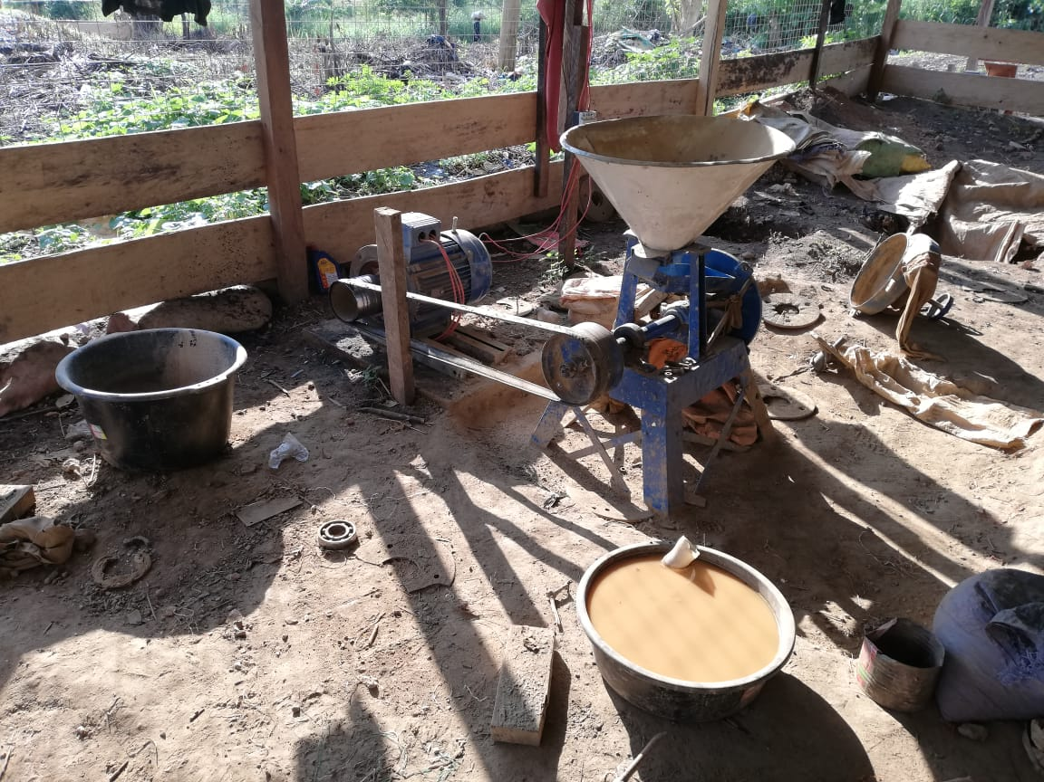
Milling workshop

Slide 9
Criminalisation persists
Regulation created new conditions for criminalisation; bureaucratic red tape, cost of accessing licenses (associations organising groups to purchase licenses), preferred concessions not being offered; exclusions persist
Chiefs facilitate access to land for unlicensed operations; transactional relations similar to LSM
In 2001, the entry of the New Patriotic Party into government, unleashed a coordinated military response by national security council due to pressure from the Chamber of Mines
Mandate to stop unlicensed ASM operations that were on the concessions of large scale mining companies.
Arrest, destruction of mine equipment and eventually a resettlement program, negotiations with Galamsey miners.
Chinese investment significant; criminalised form of investment; collaboration with Ghanaians

Slide 10
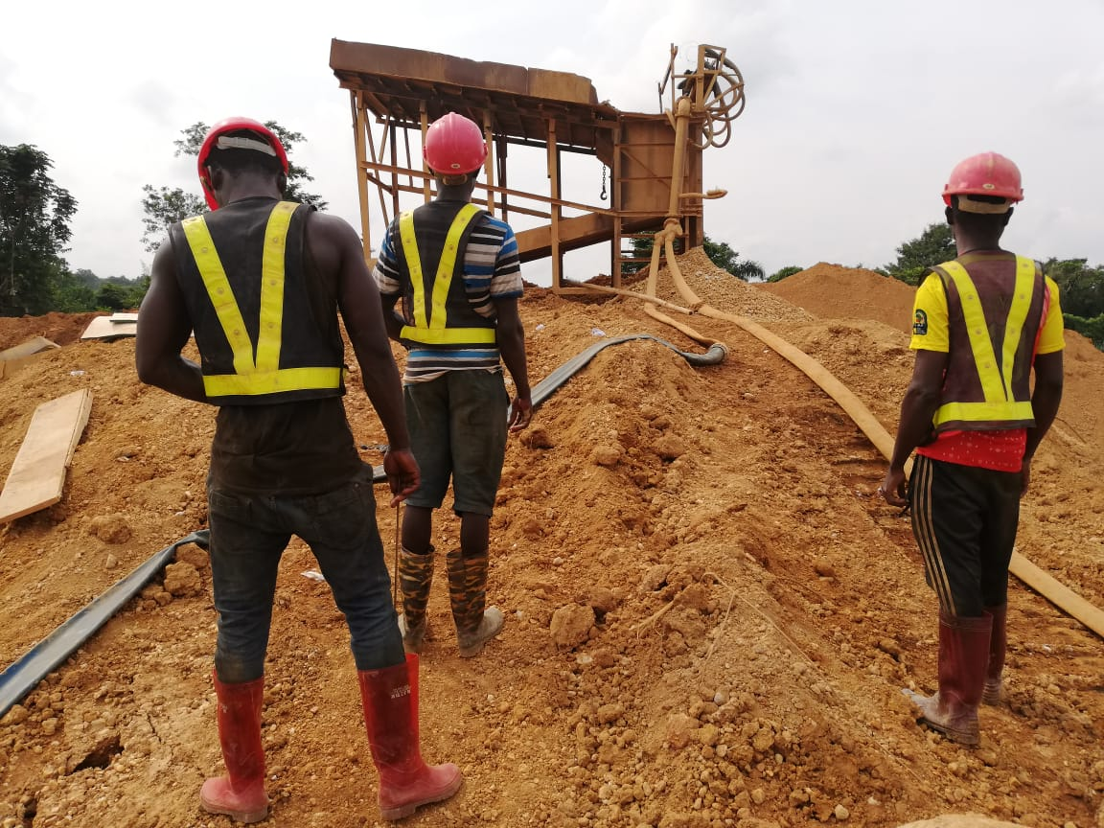
Large scale siltation device, ASM mineworkers in Central Region

Slide 11
Mr. Elimah (Interview, 2017) explains the manner that criminalisation has placed constraints on small scale investors and producers.
Instead of bastardizing the Chinese … why don’t we have a certain kind of collaboration with them tell them that you can’t do mining - but then we’ll buy your technology because they are able to recover more of the gold than what our own indigenous people are able to do. So why don’t we buy their technology and then apply that to our own indigenous mining business so that they can recover more of the gold and then save our environment in some way...
So the issue is not so much the involvement of Chinese but more about their involvement in small-scale mining. So we need to be attracting more Chinese into large-scale mining so that we reserve the small-scale mining for Ghanaians as the law seeks to do...I am talking about well-established Chinese companies dealing with the state and then acquiring the license through the normal processes we know and then doing mining like all other multinational companies are doing. That for me is a better option than the current chaotic approach, where every Chinese who gets a few dollars can move from Beijing to Accra, meet a Ghanaian middle man who gets them a concession and they move equipment in there, destroys the environment and leave the place as it is and move out.

Slide 12
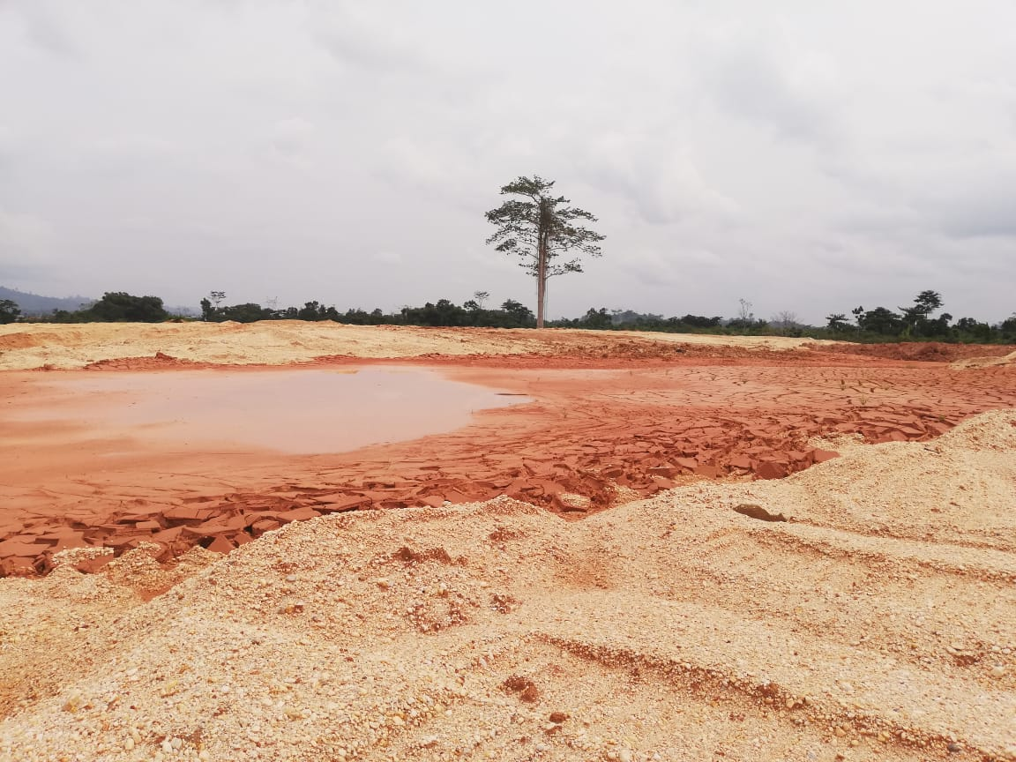
Reclaimed ASM site

Slide 13
Stimulates retail sector beyond mining
Mr Haruna Essiedu explains further.
There were those who [were] also selling items such as rice, cooking oil, tin tomato, fish, all these people were gainfully employed by the galamsey. Let me give you some examples, there were some Lebanese who moved to Obuasi to rent stores at Horsey Park and were selling the items I have mentioned above in large quantities, they are no more there because the galamsey has shut down. The sector really helped the local community in so many ways, as we speak I have...sponsored six people by paying for their medical bills for hernia operations.

Slide 14
Obuasi occupation
In 2013, the military and police unit, which had been stationed at the site ‘to maintain law and order’ was withdrawn (Nartey, 2016).
two years after the mine had stopped production and shifted to ‘care and maintenance’ while continuing to process its existing stock of ore. 3,000 small scale miners occupied the AGA shafts. The entry into the shafts is through pits and a shaft which connects into the network of tunnels underground.
Movement Committee was set up in Obuasi to negotiate the miners departure from those shafts. This committee was composed of the Minerals Commission, Adansi Traditional Council, Obuasi Small Scale Miners Association, Ghana National Small Scale Miners Association, Obuasi Municipal Assembly and the Ghana Police Service.

Slide 15
Compromise?
60% of their concession for ASM miners. This was to be transferred to the Government of Ghana through the Minerals Commission to other parties and could be worked on by ASM miners once the moratorium is lifted.
Galamsey doubt that these areas will be profitable for ASM miners. mapping exercise was conducted by AGA on behalf of the Minerals Commission showing the areas which are profitable for ASM operators.
Pessimism validated with government attempt to license Angel Group of Companies to set up an operation on 60% ceded by AGA.

Slide 16
Response from GNASSM
The Obuasi Branch of the GNASSM condemned this in a press conference held on November 28, 2018 (Abeam, 2018).
‘The chiefs, elders, opinion leaders, small-scale miners in the Obuasi Municipality and Amansie strongly object ... to Angel Group of Companies, and warn the Minerals Commission to immediately stop processing particulars on the concession and avoid any conflict...We want AGA to have their peace to work without any problem with the Obuasi Community to ensure investor confidence for the progress of Obuasi and Mother Ghana.’

Slide 17
a galamsey miner on the state
In the aftermath of a mass arrest of mineworkers a financier explains:
So when I went to the police station to write my statements, they called the Municipal Chief Executive (MCE) what he said was if I have been arrested then they need to arrest the chief of the area as well. they brought the chief to the police station as we all know chiefs don’t do illegal mining (galamsey) so they should leave him alone and deal with me. So I told them I wasn’t an illegal miner, because if I were I wouldn’t have done renovation at their police station and at the clinic.
When I was renovating their station for them (Police) why didn’t they question me on what basis was I doing it, but instead looked on for me to do it for them only to come back and arrest me for doing illegal mining? If the government had supported me, I would have gone far. The state should rather support the sector to thrive than kicking against it. It got to a point the company even told me they want to pay me off so I can leave their concession for them but I refused.

Slide 18
Galamsey miner on the state
As Alhaji Ben Abdullah, a financier explains the implication of the ban:
…so if the state stops us just in the middle of it as it has done now and we’re unable to educate our children they will also have no other choice than the galamsey and the chain will continue, you can kill all of today or tomorrow there will be another set of people doing the same work unless you allow to system to end itself.

Slide 19
General Conclusions
The apparent contradictory interventions by the state are underscored by an overriding interest in preserving the dominance of LSM operations and hence disarticulation
Current measure to introduce community mining with local government guiding projects that bring together of small scale miners and investors with the aim of building the local economy; state led process. Intends to deploy mechanisation with honeycomb method; women excluded
Early stages, direction this policy initiative will take? Can the state act in the interests of small-scale producers? Can local government provide the vehicle for this? Capacity?
On October 23, 2016 at a demonstration by the GNASSM in Obuasi
‘Is AGA bigger than Ghana? ... Is the current governing body helping AGA destroy the peace and harmony of Obuaseman?’

