Slide 1

The digital transformation of the automotive industry
Connected cars, autonomous driving, next generation manufacturing -
Challenges for Trade Unions
IndustriAll auto meeting Toronto Oct. 14th 2015

Slide 2
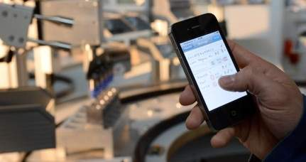
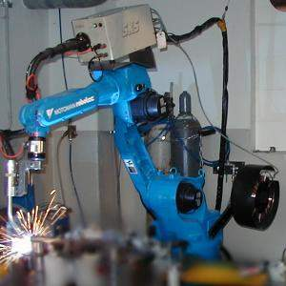
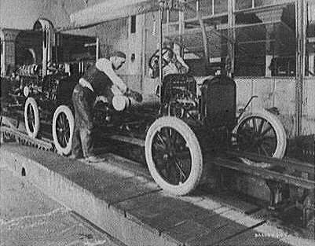
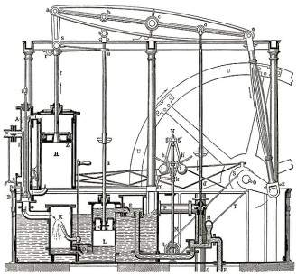
From the first to the fourth industrial revolution
4. Industrial revolution
Based on cyber-physical-
systems
3. Industrial revolution
Through the use of electronics
and IT further progression in
autonomous production
2. Industrial revolution
Introducing mass production
lines powered by electric
energy
Level of complexity
1. Industrial revolution
Introducing mechanical
production machines powered
by water and steam
Industry 1.0
Industry 2.0
Industry 3.0
Industry 4.0
End of the
18th century.
Beginning of the
20th century
Beginning of the
70th
Today
Source: DFKI/Bauer IAO

Slide 3
Industry 4.0 as part of a digitized economy
Internet of things
Digitized services
Industry 4.0
…
Labor 4.0
Smart products
Smart factory
Product innovation
Process innovation
Autonomous agents
Digital networking

Slide 4

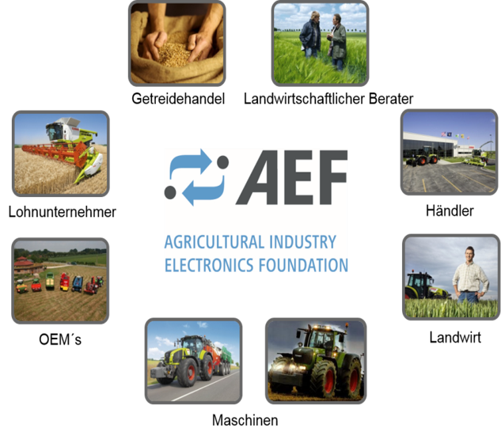
New value chains through digital infrastructure
New organization of value chains. On the one hand through vertical network distribution, product development and services. On the other hand through horizontal network distribution between supplier, contractor and customer. Value chains generate hybrid products (Part material part service part knowledge)

Slide 5
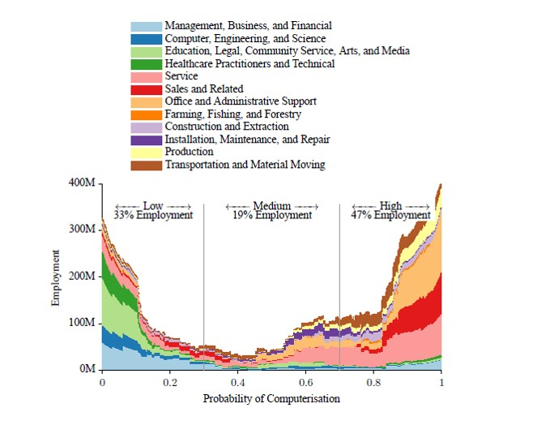
Quantitative repercussions on the number of employees
47% of US-Americans have a high risk of further digitalization and automation of their workplace.
The impact on employees is not jet quantifiable. One group sees the digitalization as part of the future job market. Others fear the loss of jobs and the spreading of precarious employment.

Slide 6
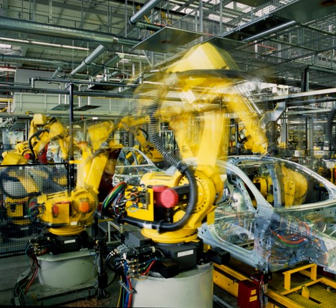
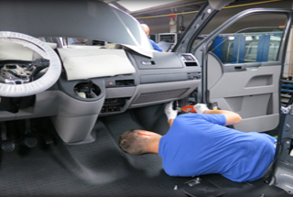
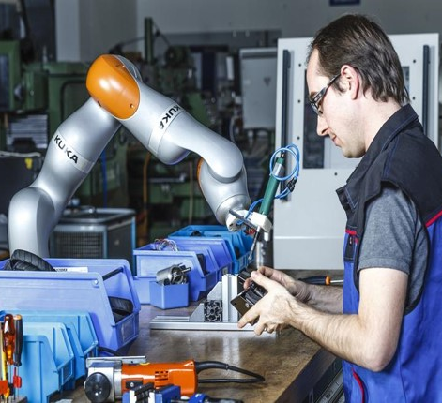
Robots as colleagues instead of work tools
Ergonomic relief for the older staff member. Highly incriminating and physical tough jobs reducing new tasks and the need for qualifications (programing?)
Robots as training partner? Or as gateway to inferior jobs

Slide 7
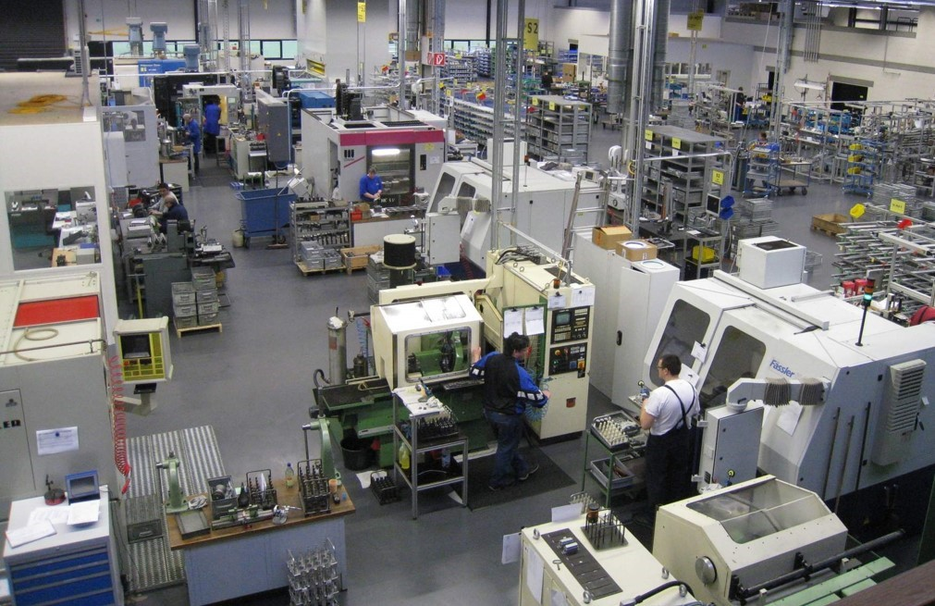
Just a normal day in the smart factory
Task to the production system – Order: 500pcs. in one week
I cant do Saturday
Two hours overtime today!
Magazine is empty! Please refill!
I refill the magazine.
Capacity's are overloaded till Friday
Turn me on!
Your BBQ weekend is canceled
I can work this Saturday.
I got to be at the goods issue in 2 hours

Slide 8
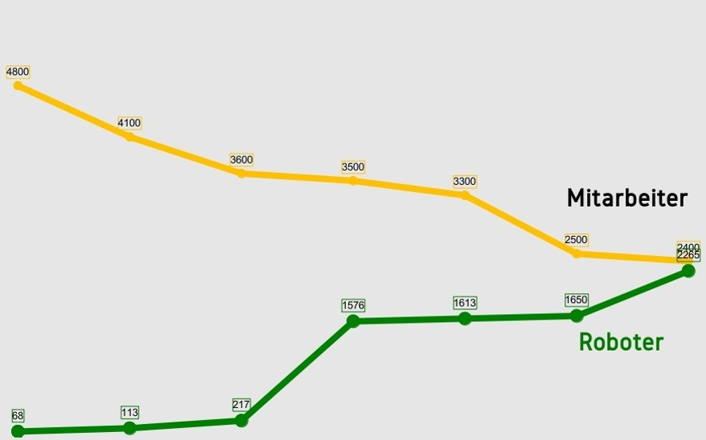
Transformation of work structures at the automotive auto body manufacture (e.g. VW Golf)

Slide 9
Steps to „Industry 4.0“, Examples
Manufacturing
replacing human work
man-machine collaboration
3D - Printing
Augmented Reality (training / support / advice through dataglasses)
Shift/working hours-coordination over the internet
Remote control of production equipment
Engineering
Computer based simulation
extended usage of cloud-computing and crowd-sourcing
Source: Wikipedia

Slide 10
Steps to „Industry 4.0“, Examples
Maintenance
Remote controlled maintenance
Data-glasses, computer based support for decision making
Exensive use of sensors to monitor the state of production equipment
Production control
paperless logistics
traceability of products and parts (realtime information of inventory)
RFID
digital memory of the product
optimisation of production with BIG DATA
Source: Wikipedia

Slide 11
Challenges for the workforce
rapid change of necessary qualification
ergonomical improvement through the use of robots
creation of new jobs for high skilled workers in thea areas of planning, configuration and maintenance of the new technologies
expansion of low-skilled work through the use of robots and assisting systems
Extensive control and monitoring of workers behavior and performance
Increased expections regarding individual flexibility
Source: Wikipedia

Slide 12
Challenges for the society
increase of precarious work (agency work, outsourcing, crouwdsourcing, solo-self-employed)
race to the bottom on social standards
where are the jobs for low-skilled workers and the non-digital-natives
Source: Wikipedia

Slide 13
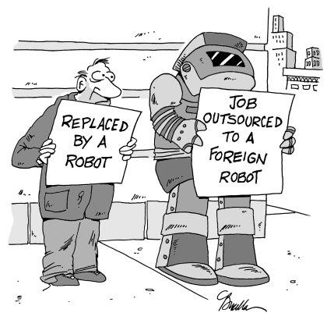
Transformation of the automotive industry

Slide 14
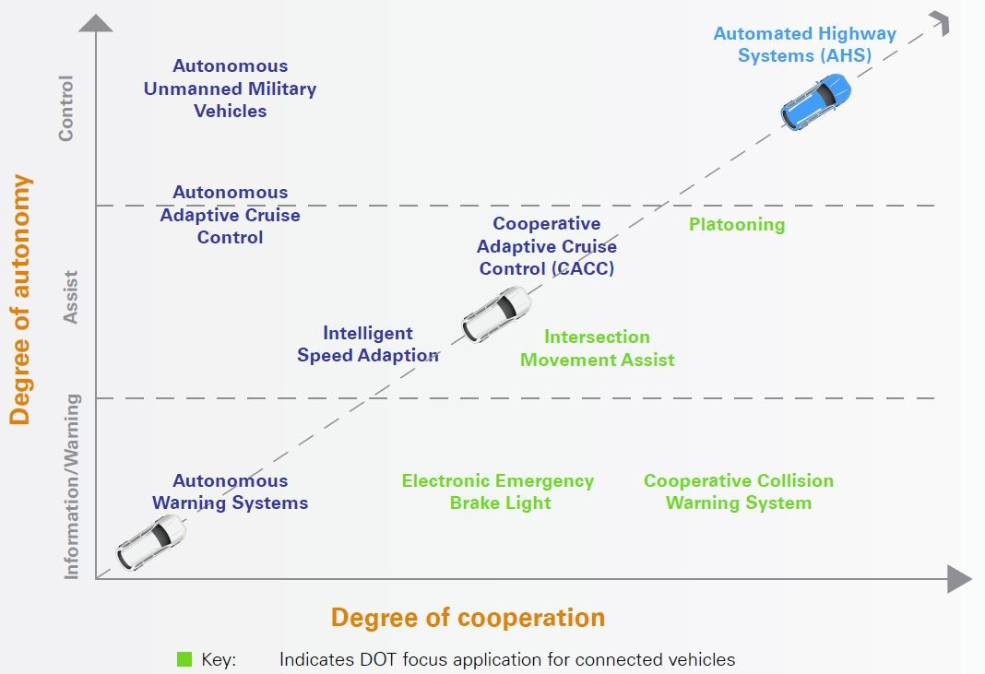
Automation steps of the vehicle

Slide 15
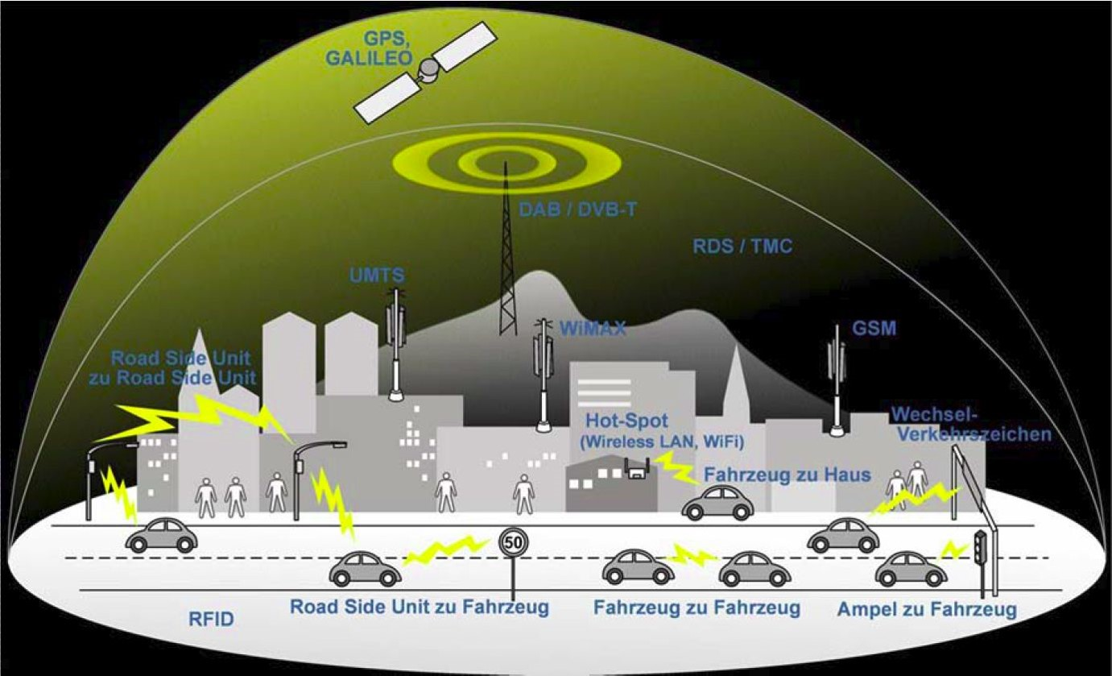
Combining vehicle networking with global infrastructure

Slide 16
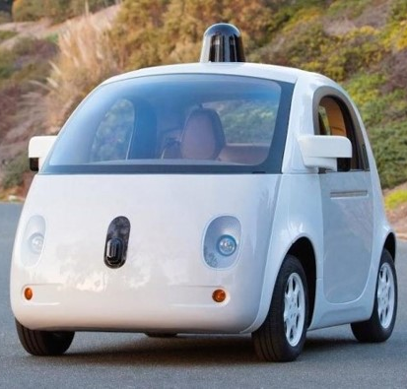
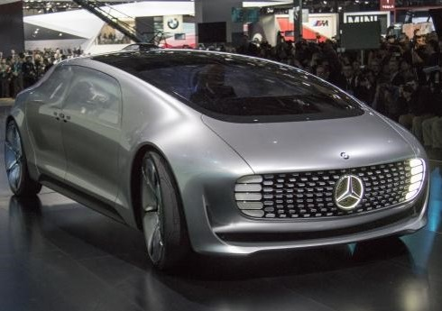
Autonomous driving – Transformation of products
Standardization vs. Individuality

Slide 17
Connected and autonomous cars - advantages
Fewer traffic collisions,
Increased roadway capacity and reduced traffic congestion
Relief of vehicle occupants from driving and navigation
Removal of constraints on occupants' state (age, unlicensed, blind, distracted, intoxicated, …)
Reduce total number of cars by increased car sharing, higher utilization rate of the car
Reduction of physical space required for vehicle parking, higher car density on the road possible
Elimination of redundant passengers – the robotic car could drive unoccupied to wherever it is required
Removal of the steering wheel, no occupant needs to sit in a forward facing position.
Source: Wikipedia

Slide 18
Connected and autonomous cars - challenges
Liability for damage
Resistance by individuals to forfeit control of the car
Software reliability
A car's computer could potentially be compromised, as could a communication system between cars.
Implementation of legal framework and government regulations for self-driving cars.
Loss of driving-related jobs.
Loss of privacy
  governmental access to movement data,
  who owns the data?
Ethical problems
Source: Wikipedia

Slide 19
Connected and autonomous cars – change the industry
Business models will change – sale of mobility instead of cars
  Link between public and private transport
  Car-sharing
New competitors
  IT companies enter the market to get data
  Auto-companies developing new business models to incorporate the collected data
New products, new production methods
Will the Automobile supplier become a contract manufacturer for the IT industry?

Slide 20
Challenges for the trade unions
Discuss possible changes, repercussions, the job situation but also the aftermath on society
Playing a part in political and industrial discussions to ensure and communicate the interest of our union members and employees

